Slide 1


Nguyen Giang Son
October 2021

Slide 2

Outline
Executive Summary
Introduction
Methodology
Results
Conclusion
Appendix

Slide 3
Executive Summary
In this project, I have:
Collected and cleaned SpaceX’s launch data
Explored the data to draw some conclusion about the launches
Visualized the data on a map and a dashboard
Built predictive models on whether a launch will succeed or fail
Summary of all results:
The project is rather successful and all predictive models give encouraging results.

Slide 4
Introduction
Project background and context:
SpaceX is a company that provides commercial space company that boast inexpensive rocket launches.
SpaceX’s Falcon 9 launches cost $62M, others cost at least $165M.
To keep costs low, SpaceX need to reuse the first stage of launches.
Problems you want to find answers:
Predict if the Falcon 9 first stage will land successfully.
Using that information (successful / unsuccessful landing of the first stage) to determine the price of a launch.

Slide 5


Slide 6
Methodology
Executive Summary
Data collection methodology:
Data was collected from SpaceX’s API and from Wikipedia
Perform data wrangling
Missing values were filled
Perform exploratory data analysis (EDA) using visualization and SQL
Perform interactive visual analytics using Folium and Plotly Dash
Perform predictive analysis using classification models
Multiple models were experimented and tuned to maximize their accuracy.

Slide 7
Data Collection
The data is collected using 2 methods:
Using SpaceX’s REST API.
Scraping the Wikipedia page: List of Falcon 9 and Falcon Heavy launches

Slide 8
Data Collection – SpaceX API
Present your data collection with SpaceX REST calls:
The REST API was used to collect data of booster version, launch pad, payload mass, orbit, …
Github link:
Collecting data using SpaceX API notebook
Place your flowchart of SpaceX API calls here

Slide 9
Data Collection - Scraping
Present your web scraping process:
Using BeautifulSoup, I scraped the Wikipedia page for the list of Falcon 9 launches
Github link:
Webscraping notebook
Place your flowchart of web scraping here

Slide 10
Data Wrangling
Describe how data were processed:
filling in missing values
Adding outcome label
Github link: Data wrangling notebook

Slide 11
EDA with Data Visualization
The types of charts included in this exercises are
scatter plot: to show the correlation between 2 variables
bar chart: to compare values of different categories
and line chart: to explore how a metric changed over time
Github link: EDA with Data Visualization notebook

Slide 12
EDA with SQL
Using bullet point format, summarize the SQL queries you performed
Add the GitHub URL of your completed EDA with SQL notebook, as an external reference and peer-review purpose

Slide 13
Build an Interactive Map with Folium
Summarize what map objects such as markers, circles, lines, etc. you created and added to a folium map
Markers: to mark launch sites
Circles: to mark the NASA Johnson Space Center
Lines: to visualize the distance between a launch site and the nearest city, railway, …
Github link: Folium notebook

Slide 14
Build a Dashboard with Plotly Dash
Summarize what plots/graphs and interactions you have added to a dashboard
Explain why you added those plots and interactions
Add the GitHub URL of your completed Plotly Dash lab, as an external reference and peer-review purpose

Slide 15
Predictive Analysis (Classification)
Summarize how you built, evaluated, improved, and found the best performing classification model:
Multiple models were trained on the train set: logistic regression, SVM and decision tree
They were tuned with hyperparameter tuning, then evaluated using their accuracy score on the test set
In conclusion, all models perform equally well.
Github link: Machine Learning notebook

Slide 16
Results
Exploratory data analysis results
Interactive analytics demo in screenshots
Predictive analysis results

Slide 17


Slide 18
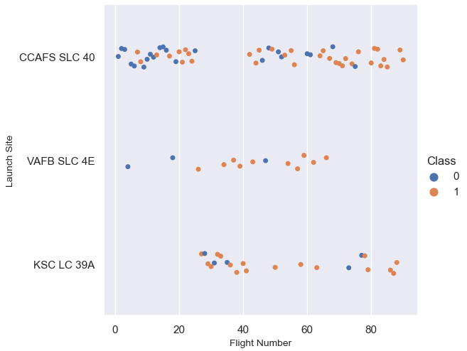
Flight Number vs. Launch Site
CCAFS SLC 40 site hosted the most flights.
The majority of flights at VAFB SLC 4E AND KSC LC 39A were from number 20+
The most recent flight at VAFB SLC 4E was flight no. 64.

Slide 19
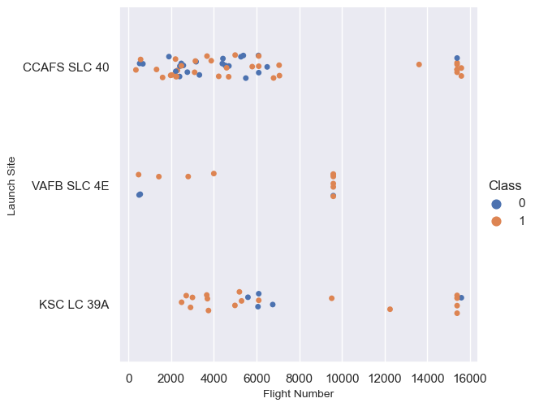
Payload vs. Launch Site
For the VAFB-SLC launchsite there are no rockets launched for heavy payload mass (> 10000kg).
For flights that carried heavy payload (> 10000kg), the failure rate were quite low (only 2 flights were unsuccessful).

Slide 20
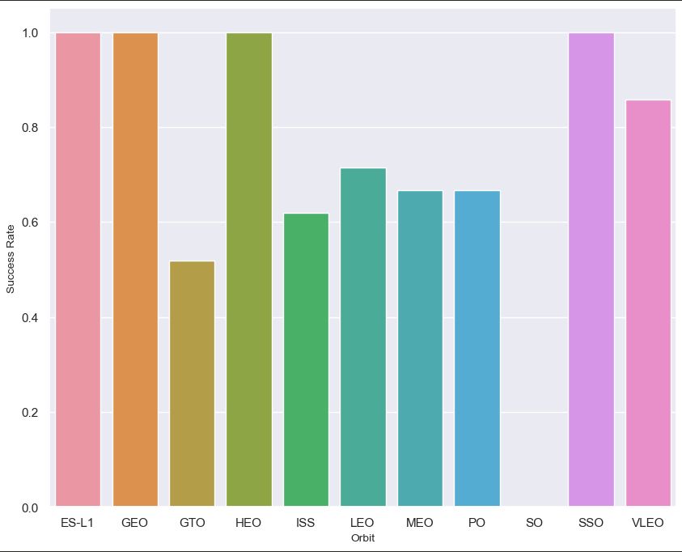
Success Rate vs. Orbit Type
For 4 orbit types (i.e: ES-L1, GEO, HEO, SSO), the success rates were 100%.
5 of 10 orbit types only had success rates between 50% and 70%.

Slide 21
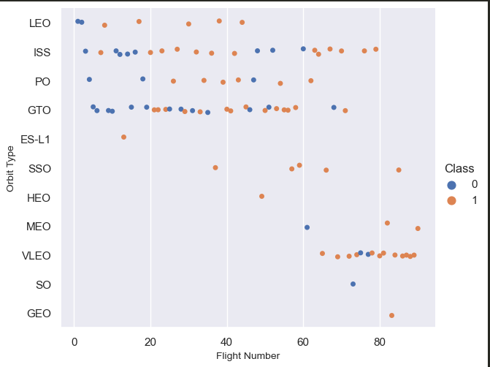
Flight Number vs. Orbit Type
In the LEO orbit the Success appears related to the number of flights;
There seems to be no relationship between flight number when in GTO orbit.

Slide 22
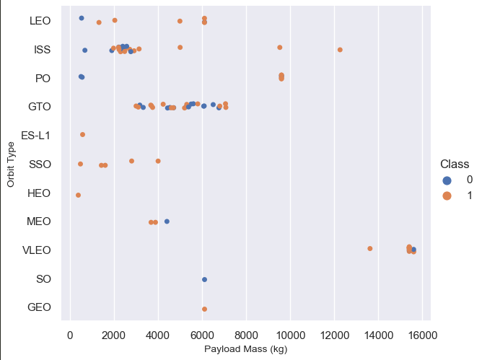
Payload vs. Orbit Type
With heavy payloads the positive landing rate are more for Polar, LEO and ISS.
However, for GTO we cannot distinguish this well as both positive landing rate and negative landing are both there here.

Slide 23
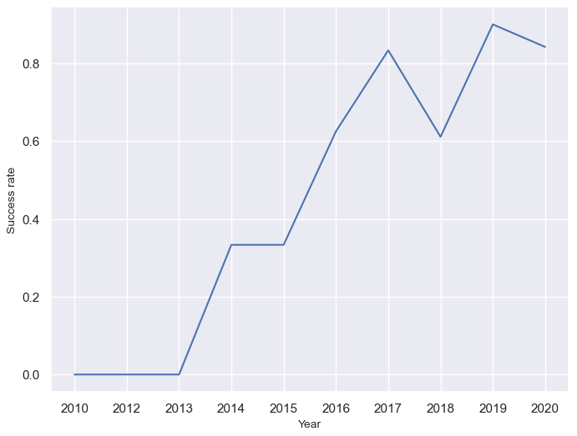
Launch Success Yearly Trend
From 2013 to 2020, annual success rates were continuously increasing (except in 2018).

Slide 24
All Launch Site Names
Find the names of the unique launch sites
Present your query result with a short explanation here

Slide 25
Launch Site Names Begin with 'CCA'
Find 5 records where launch sites begin with `CCA`
Present your query result with a short explanation here

Slide 26
Total Payload Mass
Calculate the total payload carried by boosters from NASA
Present your query result with a short explanation here

Slide 27
Average Payload Mass by F9 v1.1
Calculate the average payload mass carried by booster version F9 v1.1
Present your query result with a short explanation here

Slide 28
First Successful Ground Landing Date
Find the dates of the first successful landing outcome on ground pad
Present your query result with a short explanation here

Slide 29
Successful Drone Ship Landing with Payload between 4000 and 6000
List the names of boosters which have successfully landed on drone ship and had payload mass greater than 4000 but less than 6000
Present your query result with a short explanation here

Slide 30
Total Number of Successful and Failure Mission Outcomes
Calculate the total number of successful and failure mission outcomes
Present your query result with a short explanation here

Slide 31
Boosters Carried Maximum Payload
List the names of the booster which have carried the maximum payload mass
Present your query result with a short explanation here

Slide 32
2015 Launch Records
List the failed landing_outcomes in drone ship, their booster versions, and launch site names for in year 2015
Present your query result with a short explanation here

Slide 33
Rank Landing Outcomes Between 2010-06-04 and 2017-03-20
Rank the count of landing outcomes (such as Failure (drone ship) or Success (ground pad)) between the date 2010-06-04 and 2017-03-20, in descending order
Present your query result with a short explanation here

Slide 34


Slide 35
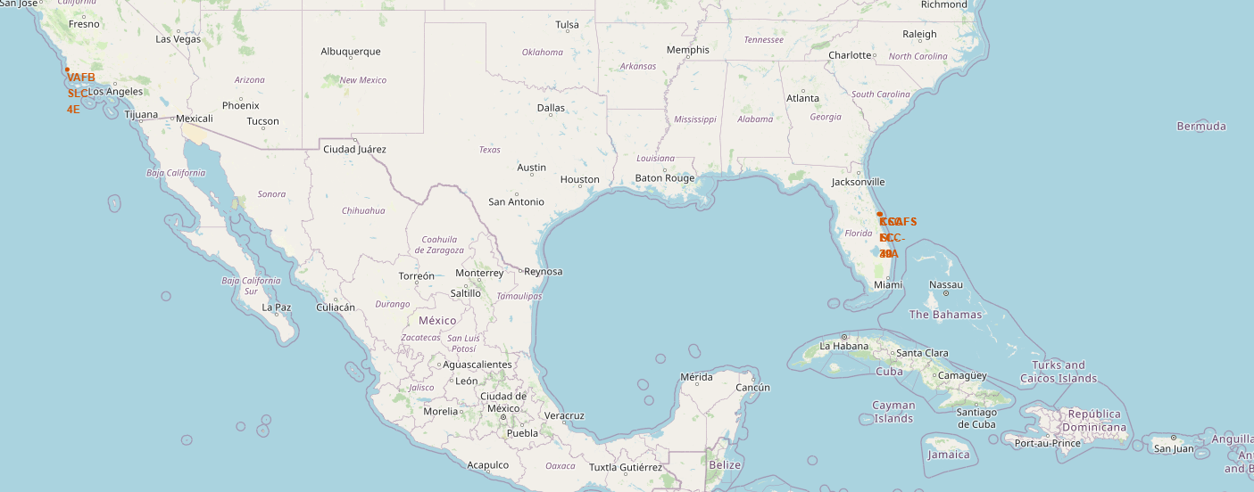
<Folium Map Screenshot 1>
This map marks the location of all 4 launch sites.
Explore the generated folium map and make a proper screenshot to include all launch sites’ location markers on a global map
Explain the important elements and findings on the screenshot

Slide 36
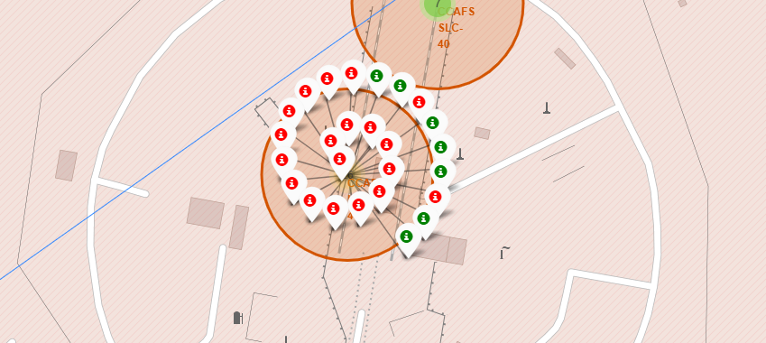
<Folium Map Screenshot 2>
This maps shows the launch outcomes as indicated by color (green = success, red = failure)
Explore the folium map and make a proper screenshot to show the color-labeled launch outcomes on the map
Explain the important elements and findings on the screenshot

Slide 37
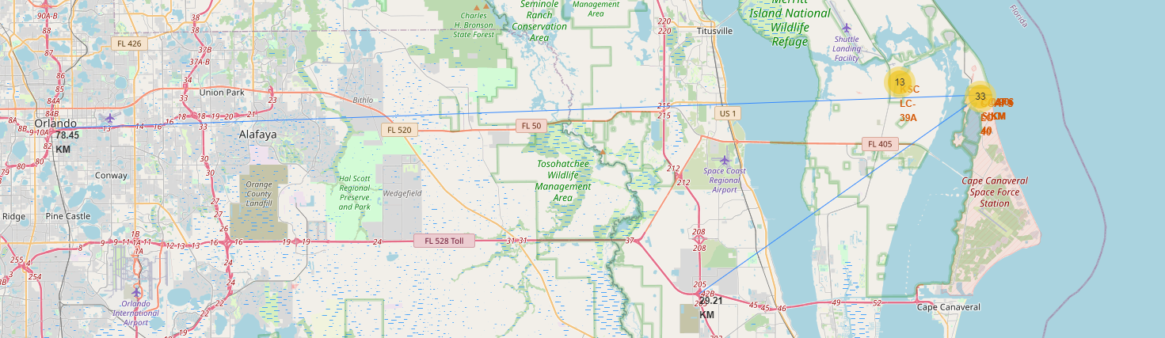
<Folium Map Screenshot 3>
This map shows the distance of a selected launch site to the nearest railroad, coastline, and city.
Explore the generated folium map and show the screenshot of a selected launch site to its proximities such as railway, highway, coastline, with distance calculated and displayed
Explain the important elements and findings on the screenshot

Slide 38


Slide 39
<Dashboard Screenshot 1>
Replace <Dashboard screenshot 1> title with an appropriate title
Show the screenshot of launch success count for all sites, in a piechart
Explain the important elements and findings on the screenshot

Slide 40
<Dashboard Screenshot 2>
Replace <Dashboard screenshot 2> title with an appropriate title
Show the screenshot of the piechart for the launch site with highest launch success ratio
Explain the important elements and findings on the screenshot

Slide 41
<Dashboard Screenshot 3>
Replace <Dashboard screenshot 3> title with an appropriate title
Show screenshots of Payload vs. Launch Outcome scatter plot for all sites, with different payload selected in the range slider
Explain the important elements and findings on the screenshot, such as which payload range or booster version have the largest success rate, etc.

Slide 42


Slide 43
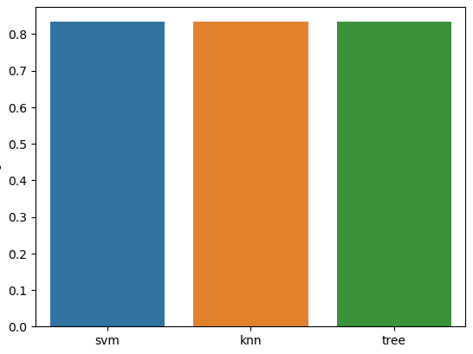
Classification Accuracy
All models (SVM, KNN and Decision Tree) perform similarly and have equal accuracy score (0.83)

Slide 44
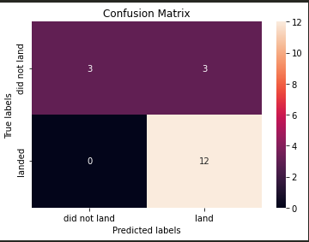
Confusion Matrix
All models give the same confusion matrix as follows:

Slide 45
Conclusions
All ML models perform equally well
Their accuracies are the same (0.83)

Slide 46
Appendix
Include any relevant assets like Python code snippets, SQL queries, charts, Notebook outputs, or data sets that you may have created during this project

Slide 47


